Slide 1
SVM Classification:

Slide 2
What is Support Vector Machine?
“Support Vector Machine” (SVM) is a supervised machine learning algorithm which can be used for both classification or regression challenges. However, it is mostly used in classification problems.

Slide 3
In this algorithm, we plot each data item as a point in n-dimensional space (where n is number of features you have) with the value of each feature being the value of a particular coordinate. Then, we perform classification by finding the hyper-plane that differentiate the two classes very well (look at the below snapshot).

Slide 4
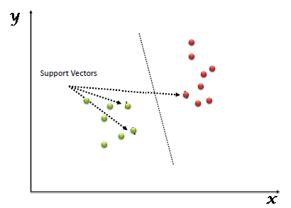
Support Vectors are simply the co-ordinates of individual observation. Support Vector Machine is a frontier which best segregates the two classes (hyper-plane/ line).

Slide 5
How does it work?
Above, we got accustomed to the process of segregating the two classes with a hyper-plane. Now the burning question is “How can we identify the right hyper-plane?”. Don’t worry, it’s not as hard as you think!

Slide 6
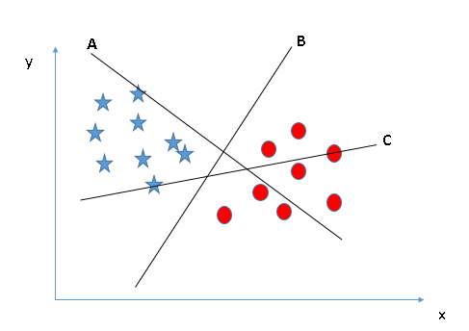
Identify the right hyper-plane (Scenario-1): Here, we have three hyper-planes (A, B and C). Now, identify the right hyper-plane to classify star and circle.
Notes:
You need to remember a thumb rule to identify the right hyper-plane: “Select the hyper-plane which segregates the two classes better”. In this scenario, hyper-plane “B” has excellently performed this job.

Slide 7
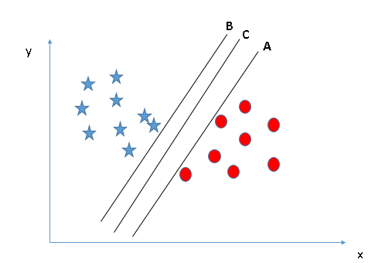
Identify the right hyper-plane (Scenario-2): Here, we have three hyper-planes (A, B and C) and all are segregating the classes well. Now, How can we identify the right hyper-plane?

Slide 8
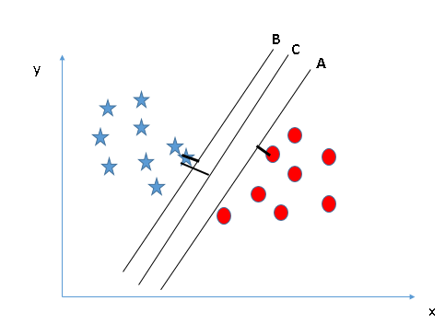
Here, maximizing the distances between nearest data point (either class) and hyper-plane will help us to decide the right hyper-plane. This distance is called as Margin. Let’s look at the below snapshot:
Notes:
Above, you can see that the margin for hyper-plane C is high as compared to both A and B. Hence, we name the right hyper-plane as C. Another lightning reason for selecting the hyper-plane with higher margin is robustness. If we select a hyper-plane having low margin then there is high chance of miss-classification.

Slide 9
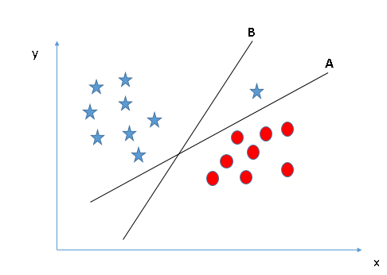
Identify the right hyper-plane (Scenario-3):Hint: Use the rules as discussed in previous section to identify the right hyper-plane
Notes:
Some of you may have selected the hyper-plane B as it has higher margin compared to A. But, here is the catch, SVM selects the hyper-plane which classifies the classes accurately prior to maximizing margin. Here, hyper-plane B has a classification error and A has classified all correctly. Therefore, the right hyper-plane is A.

Slide 10
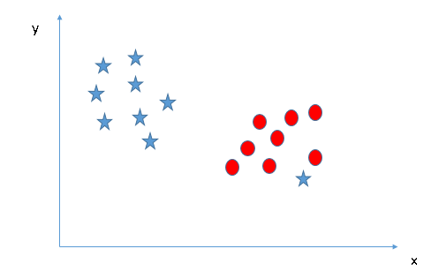
Can we classify two classes (Scenario-4)?: Below, I am unable to segregate the two classes using a straight line, as one of star lies in the territory of other(circle) class as an outlier.
Notes:
As I have already mentioned, one star at other end is like an outlier for star class. SVM has a feature to ignore outliers and find the hyper-plane that has maximum margin. Hence, we can say, SVM is robust to outliers.

Slide 11
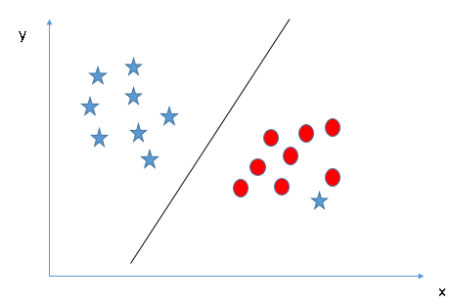

Slide 12
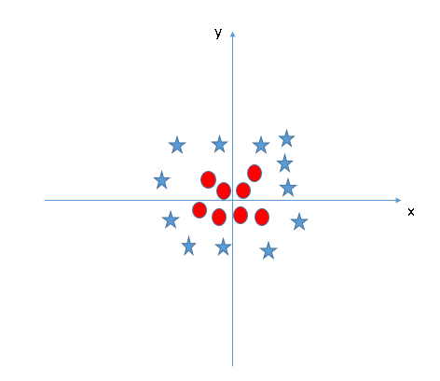
Find the hyper-plane to segregate to classes (Scenario-5): In the scenario below, we can’t have linear hyper-plane between the two classes, so how does SVM classify these two classes? Till now, we have only looked at the linear hyper-plane.

Slide 13
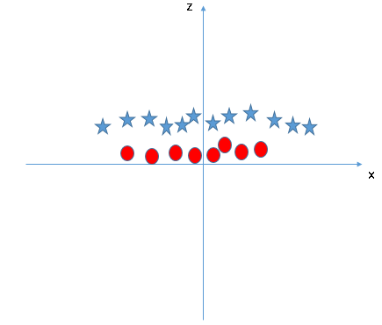
SVM can solve this problem. Easily! It solves this problem by introducing additional feature. Here, we will add a new feature z=x^2+y^2. Now, let’s plot the data points on axis x and z:

Slide 14
In above plot, points to consider are:
All values for z would be positive always because z is the squared sum of both x and y
In the original plot, red circles appear close to the origin of x and y axes, leading to lower value of z and star relatively away from the origin result to higher value of z.

Slide 15
In SVM, it is easy to have a linear hyper-plane between these two classes. But, another burning question which arises is, should we need to add this feature manually to have a hyper-plane. No, SVM has a technique called the kernel trick.

Slide 16
These are functions which takes low dimensional input space and transform it to a higher dimensional space i.e. it converts not separable problem to separable problem, these functions are called kernels. It is mostly useful in non-linear separation problem. Simply put, it does some extremely complex data transformations, then find out the process to separate the data based on the labels or outputs you’ve defined.

Slide 17
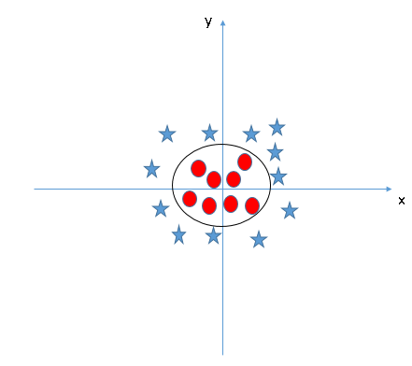
When we look at the hyper-plane in original input space it looks like a circle:

Slide 18
Support Vector Machines are popular in machine learning. In this article, we will perform SVM classification with different types of kernels provided by sklearn.svm library’s SVC class. We will use the same problem statement used in logistic regression article. We want to know whether a particular user will buy our car or not.

Slide 19
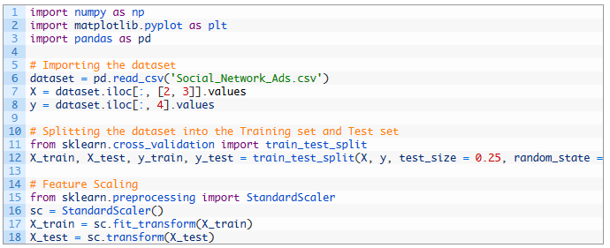
Data Preprocessing:

Slide 20
We read “Social_Network_Ads.csv” file and stored in dataset.
Extracted age and salary information from dataset and stored in X
Extracted purchase information from dataset and stored in Y.
Split dataset in training and test set so that machine can be trained using X_train and Y_train and X_test and y_test can be used as test set.
Used feature scaling for X_train and X_test.

Slide 21

Linear SVM Classification:
We imported Support Vector Classifier i.e. SVC from sklearn.svm
created a classifier object with a linear kernel
fitted classifier with X_train and y_train.
That’s it, we have created our classifier, let plot classification graph and compare actual i.e. y_test results.

Slide 22
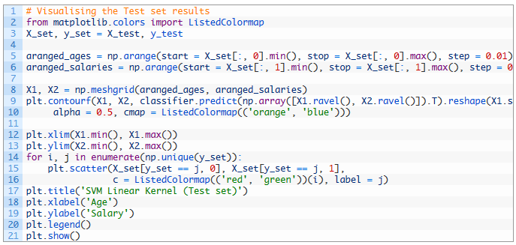

Slide 23
aranged_ages variable will have scaled ages of users starting from minimum age to maximum age incremented by 0.01.
aranged_salaries variable will have scaled salaries of users starting from minimum salary to maximum salary incremented by 0.01.
np.meshgrid() takes aranged_ages and aranged_salaries to form X1 and X2.
X1 and X2 are used for creating a graph which classifies all data points using SVM classification. It is done using plt.contourf(), method.
Then we plot actual data points from test set on graph to compare them with classification.

Slide 24
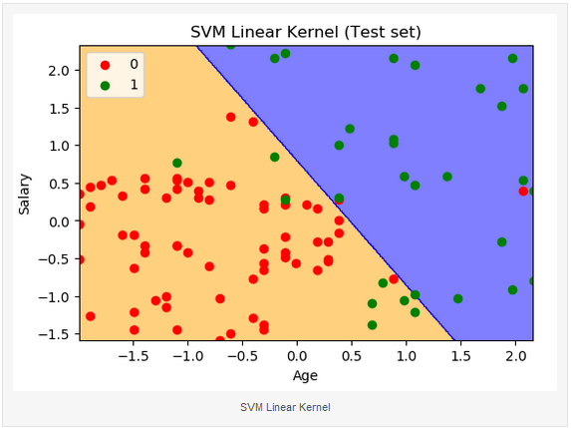

Slide 25
Orange and blue sections denote users who will not and who will buy the car respectively
red and green points denote users who didn’t buy and who bought the car.
As per graph, we can see 8 green points in orange area and 2 red points in blue area. It means out of 100, 10 predictions are wrong and 90 are correct

Slide 26
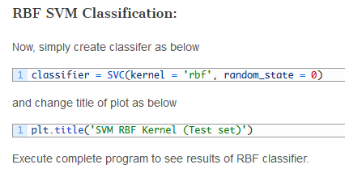

Slide 27
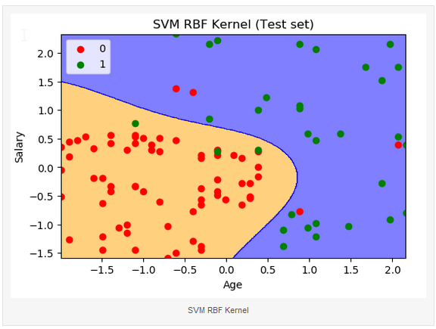
Notes:
Note 4 red points in blue area and 3 green points in orange area. It means 93 predictions out of 100 are correct and 7 are wrong

Slide 28
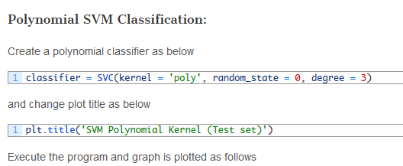

Slide 29
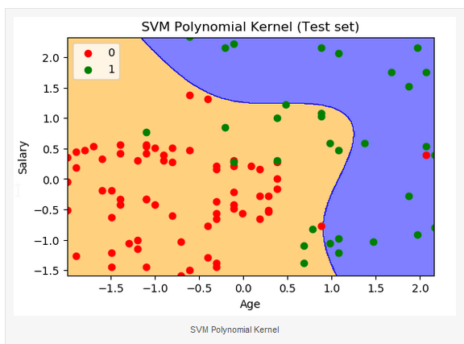
Notes:
There are 13 green points in orange area and 1 red point in blue area. It means out of 100, 86 predictions are right and 14 are wrong.

Slide 30
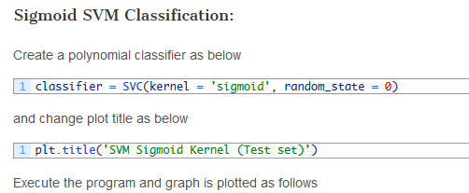

Slide 31
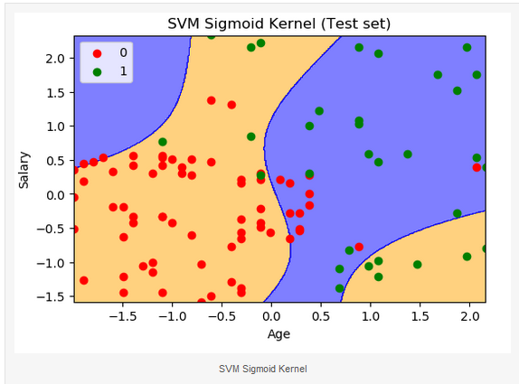
Notes:
12 green points are observed in orange area and 14 red points in blue area. It means out of 100, only 74 predictions are right and 26 are wrong.

